Slide 1
Exception Handling

Slide 2
What We’ll Be Talking About Today
Exceptions in Java
Handling Exceptions
Checked vs. Unchecked Exceptions

Slide 3
What is an Exception?
An exception or exceptional event is an event that occurs during the execution of a program that disrupts the normal flow of instructions.
The following will cause exceptions:
Accessing an out-of-bounds array element
Writing into a read-only file
Trying to read beyond the end of a file
Sending illegal arguments to a method
Performing illegal arithmetic (e.g divide by 0)

Slide 4

Exception Terminology
When an exception occurs, we say it was thrown or raised.
When an exception is dealt with, we say it is handled or caught.
The block of code that deals with exceptions is known as an exception handle.

Slide 5
Why use Exceptions?
Compilation cannot find all errors
To separate error handling code from regular code
Code clarity (debugging, teamwork, etc.)
Worry about handling error elsewhere
To separate error detection, reporting, and handling
To group and differentiate error types
Write error handlers that handle ver specific exceptions

Slide 6
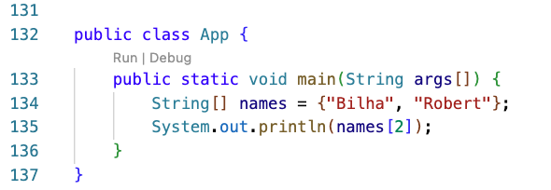
Decoding Exception Messages
The println in the above code causes an exception to be thrown with the following exception message:
Exception in thread "main"
java.lang.ArrayIndexOutOfBoundsException: 2 at
App.main(App.java:4)

Slide 7
Exception Message Format
Exception messages have the following format:
[exception class]:
[additional description of exception] at
[class].[method]([file]:[line number])

Slide 8
Exception Messages Mini Pop-Quiz
Exception message from array example:
java.lang.ArrayIndexOutOfBoundsException: 2 at
App.main(App.java:4)
What is the exception class?
Which array index is out of bounds?
What method throws the exception?
What file contains the method?
What line of the file throws the exception?

Slide 9

Throwing Exceptions
You can also throw Exceptions at will.
The throw statement requires a single argument: a throwable object
Throwable objects are instances of any subclass of the Throwable class
Include all types of errors and exceptions
Check the API for a full listing of throwable objects

Slide 10
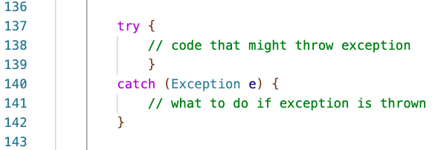
Handling Exceptions
You can use a try-catch block to handle exceptions that are thrown:
try {
// code that might throw exception
}
catch ([Type of Exception] e) {
// what to do if exception is thrown
}

Slide 11
Handling Multiple Exceptions
You can handle multiple possible exceptions by multiple successive catch blocks:
try {
// code that might throw multiple exceptions
}
catch (IOException e) { .. }
catch (ClassNotFoundException e2) { .. }

Slide 12
Finally Block
You can also use the optional finally block at the end of the try-catch block
The finally block provides a mechanism to clean up regardless of what happens
within the try block
Can be used to close files or to release other system resources

Slide 13
Try-Catch-Finally Block
try {
// code that might throw exception
}
catch ([Type of Exception] e) {
// what to do if exception is thrown
}
finally {
// statements here always get executed, regardless of what happens in the try block
}

Slide 14
Checked Exceptions
Checked exceptions or non runtime exceptions are exceptions that occur in code outside of the Java runtime system
For example, exceptions that occur during I/O are non runtime exceptions
The compiler ensures that non runtime exceptions are caught or are specified to be thrown (using the throws keyword)

Slide 15
Unchecked Exceptions
Unchecked exceptions or runtime exceptions occur within the Java runtime system
Examples of unchecked exceptions
arithmetic exceptions (dividing by zero)
pointer exceptions (trying to access an object’s members through a null reference)
indexing exceptions (trying to access an array element with an index that is too large or too small)
A method does not have to catch or specify that it throws unchecked exceptions, although it may

Slide 16
Handling Checked Exceptions
Every method must catch checked exceptions OR specify that it may throw them (using the throws keyword):
void readFile(String filename) {
try {
FileReader reader = new
FileReader("myfile.txt");
} catch (FileNotFoundException e) {System.out.println("file was not found");}
}
VS.
void readFile(String filename) throws FileNotFoundException {
FileReader reader = new FileReader("myfile.txt");
// read from file . . .
}

Slide 17
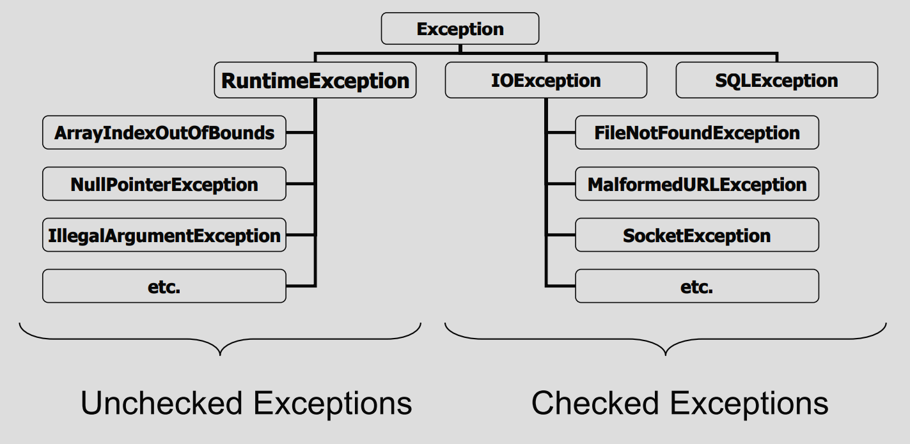
Exception Class Hierarchy
Look in the Java Docs for a full list of exceptions

Slide 18
Exceptions
There are tons of different Exceptions, however, the ones you’ll likely use most will be:
IOException,
Or simply Exception

Slide 19
Exception
Be Careful when trying to catch the Exception exception as it will be triggered no matter what the exception is.
It is an extremely handy tool when trying to identify problems as you can store and print the exception.
While its not good official practice the Exception exception is a nice catch all handler that allows you to move on without fixing something.

Slide 20
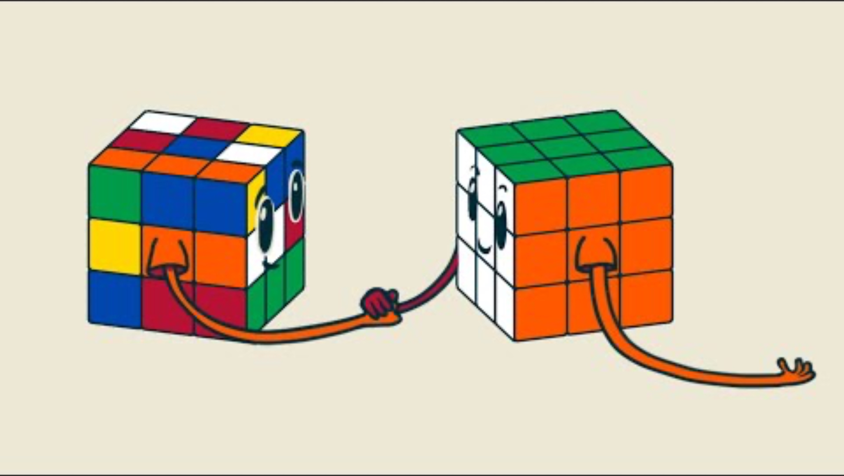

Slide 21
Closing
Office Hours In SS-411:
Tu & Th 2:00pm – 3:00pm
Mon & Wed 12:30pm–1:30pm

